Slide 1
Compilo test automation
Kasun Ratnayake | Test automation Lead
Notes:
IN this session we will talk about
the selected tool
Demo on the selected scenarios for POC
test maintenance
Reporting
Continuous integrations
some testing aspects

Slide 2

The Selected Tool
Codeception is using a PHP framework
The tool is well established
Supports Unit test, Functional tests and Acceptance tests
Can be easily plugged with selenium
Supports cross browser testing
Written tests are simple and easy to understand
Isolated page objects and data inputs helps in maintenance
Notes:
Why did we selected this tool,
we were planning to use java with selenium, but since your application is build on PHP we decided a php based test tool will suite your technology stack and to test maintenance in the future
Tool released to the market in 2011 and currently we are in Codeception 3, but as per their web site codeception version 4 will be released in the near future, this is a developing tool, it has very good documentation
Usually unit and functional test are small test cases but acceptance test is the UI test which is running test scenarios
Not only selenium, this tool support various other platforms like browserstack, phpunit, phantom JS etc…

Slide 3

Demo

Slide 4
Maintaining the tests
Tests can be written fast if we don’t pay much effort in creating separate
Classes
Data sheets
Page objects
When something changes in the application, its really hard and time consuming to update such a messy code
Page object model and data isolation data is very important when maintaining tests
Notes:
Automation test are very usefull until they work, if something is changed in your application and if its takes lot of time to update the code to adhere to the change there is no point of using that automation suite
Adding a remember me function to a login
The tests can be also run with parreral browsers at the same time

Slide 5
Lets look at a login scenario
Class Login
{
$I->fillField('#asdasd', 'employee');
$I->fillField('#xfgmasda', 'employee');
$I->click('Logg inn');
}
Class Login
{
$I->fillField($element, $data);
$I->fillField($element2, $data2);
$I->click($element3);
}
Login objects
{
Element
Element2
Elemet3
}
Element ID
Data
Data1
Data2

Slide 6
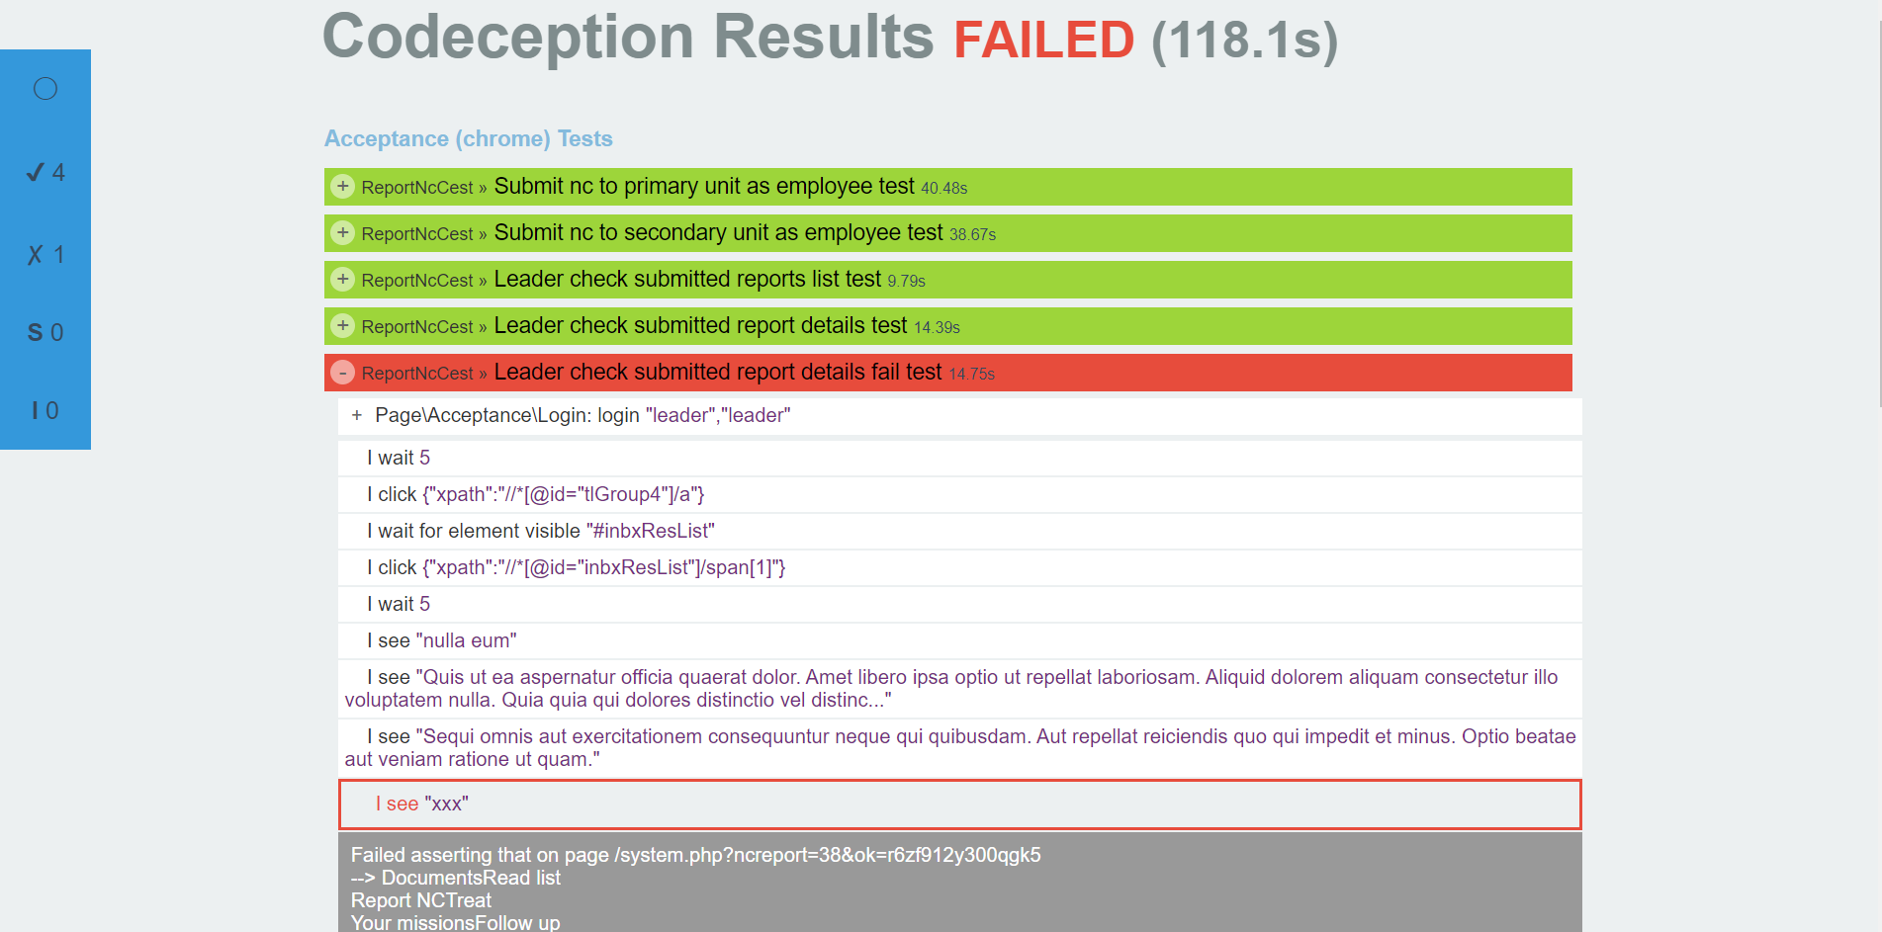
Test Reports
Codeception has its own Report module
It shows the results of the individual tests
It shows a summary
Failed scenarios can be drilled down to find the exact failure
Also takes a screenshot when a failure occurs
Notes:
lastpoint
When a test is failed lets say due to a network issue, you can just check the screenshot and see what has gone wrong

Slide 7
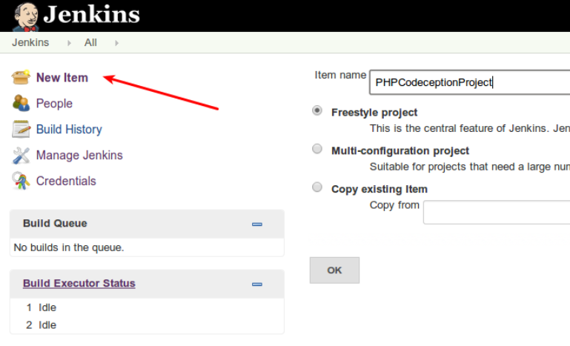
Continuous integration
When the test suite is completed, the tests should also run automatically
Codeception suggests Jenkins for this matter
Codeception generates a XML file as test results and that can be read using Jenkins to get a proper dashboard for test results
An email could be generated with the test results
Notes:
Schedule the tests to run on a specific time, else on a specific build
Test results can also be presented as a trend graph

Slide 8
ROI and other features
The time we can save by introducing this automation tool
An automation suite can test all the possible combinations
The test an be run daily and at any point the product owner can get an idea on the quality of the product
For a manual tester the same test should be repeated for cross browser testing, but in automation it saves that time.
When the test suite is ready, it can be customized to run a selected number of tests( as smoke tests) or the full regression test (as acceptance test)
Notes:
To create an nc, how much time a manual tester takes

Slide 9
Thank You!
www.99xtechnology.com

